Slide 1

User Engagement Analysis
Restaurant Success
Nafis Ansari​​

Slide 2

About YELP
Yelp is a popular web and mobile platform that serves as a crowd-sourced repository for local business reviews. Users contribute by submitting reviews, photos, and tips about various businesses, while also accessing information, ratings, and feedback shared by others.
2

Slide 3

AGENDA
Problem Statement
Research Objective
Hypothesis
Data Overview
Analysis and Findings
Recommendations

Slide 4

Problem statement
In the highly competitive restaurant industry, understanding the key drivers of business success is essential for stakeholders. This project leverages the Yelp dataset to examine the relationship between user engagement (e.g., reviews, tips, and check-ins) and business performance metrics, such as review count and average ratings, specifically for restaurants.
Market gap
Customers
Financial Impact
Restaurants lack advanced tools and data insights to adapt to evolving customer expectations effectively.
Identifying how user engagement (e.g., reviews, tips, check-ins) correlates with business performance metrics like ratings and review counts.
Leveraging data insights can potentially lead to measurable improvements in revenue and operational efficiency.
COSTS OF INEFFICIENCY
USABILITY NEEDS
Missed potential revenue due to inadequate tools for tracking and analyzing customer feedback.
Businesses require simple, actionable solutions to interpret customer sentiment and engagement trends effectively.

Slide 5




Research objective
Quantify the correlation between user engagement(reviews, tips, check-ins) and review count/average star rating.
Analyze the impact of sentiment on review count and average star rating.
Time Trends in User Engagement
5

Slide 6

Hypotheses
Correlation Between Engagement and Performance: Higher levels of user engagement (e.g., increased reviews, tips, and check-ins) are positively associated with higher review counts and star ratings.
Sentiment Influence: Positive sentiment in user reviews and tips significantly contributes to improved ratings and greater review counts.
Consistency in Engagement: Restaurants that maintain consistent user engagement over time experience more sustained success compared to those with sporadic engagement patterns.
6

Slide 7
Data Overview
This dataset is a subset of Yelp and has information about businesses across 8 metropolitan areas in the USA and Canada.
The original data is shared by Yelp as JSON files.
The five JSON files are business, review, user, tip and check-in.
The JSON files are stored in the database for easy retrieval of data.
7

Slide 8

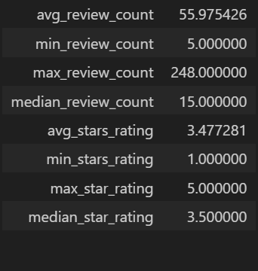
Analysis and findings
Out of 150k businesses, 35k are restaurants business and are open.
Table shows distribution of business success metrics (review count and average rating):

Slide 9
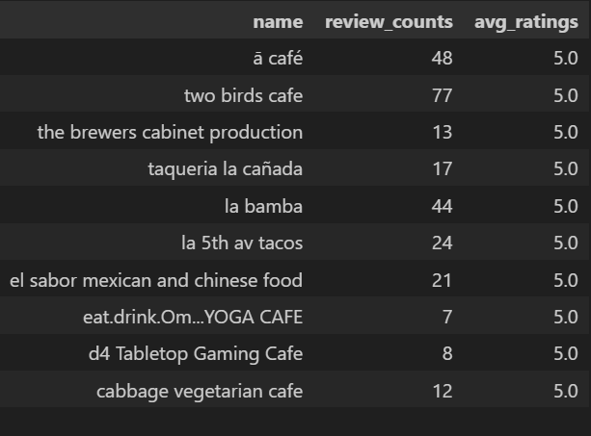
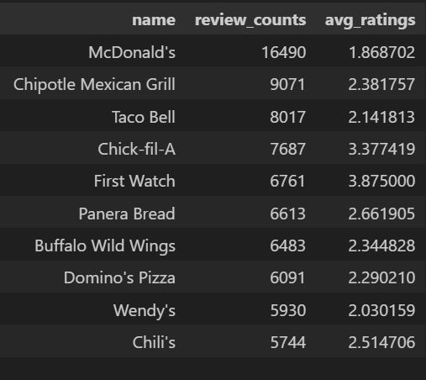
Highest rating
Highest Review count
Higher ratings do no guarantee a higher review count, or vice versa.
Success of Restaurants is not solely determined by ratings or review counts.
Review count reflects user engagement but not necessarily overall customer satisfaction or business performance.
9

Slide 10
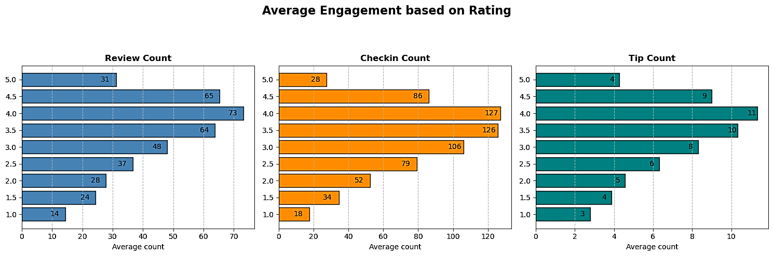
Do restaurants with higher engagement tend to have higher ratings?
Data shows a general increase in average review, check-in, and tip counts as ratings improve from 1 to 4 stars.
Restaurants rated 4 stars exhibit the highest engagement and shows a downward trend for rating above 4.
The drop in engagement at 5.0 stars might suggest either a saturation point where fewer customers feel compelled to add their reviews, or a selectivity where AVG Engagement based on Rating Check-in Count only a small, satisfied audience frequents these establishments.
10

Slide 11
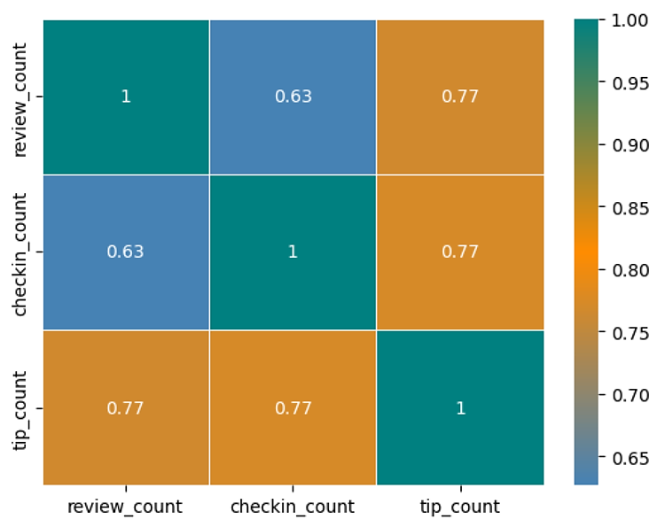
Is there a correlation between the number of reviews, tips, and check-ins
for a business?
Interlinked User Engagement: The high correlations suggest that user engagement across different platforms (reviews, tips, and check-ins) is interconnected. When users engage with a business in one way (e.g., leaving a review), they are more likely to engage in other ways as well (e.g., leaving a tip or checking in).
Focus on Multi-Platform Engagement:
Businesses should focus on strategies that
boost all types of user engagement.
Increasing engagement in one area is likely
to drive increases in others, leading to
enhanced overall visibility and
interaction with customers.
11

Slide 12
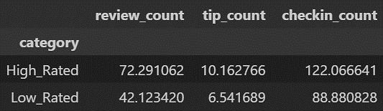
Is there a difference in the user engagement between high-rated and
low-rated businesses?
Data indicates a clear correlation between higher ratings and increased user engagement across reviews, tips, and check-ins.
This pattern underscores the importance of maintaining high service and quality standards, as these appear to drive more reviews, check-ins, and tips, which are critical metrics of customer engagement and satisfaction.
12

Slide 13
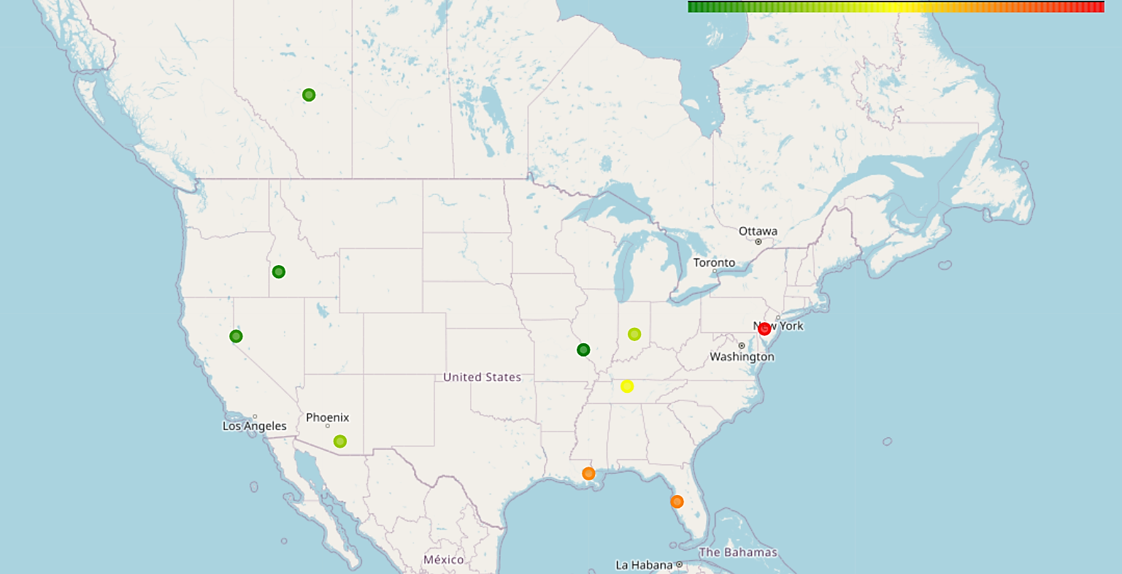
How do the success metrics of restaurants vary across different states and cities?
Philadelphia emerges as the top city with the highest success score, indicating a combination of high ratings and active user engagement.
Following Philadelphia, Tampa, Indianapolis, and Tucson rank among the top cities with significant success scores, suggesting thriving restaurant scenes in these areas.
13

Slide 14
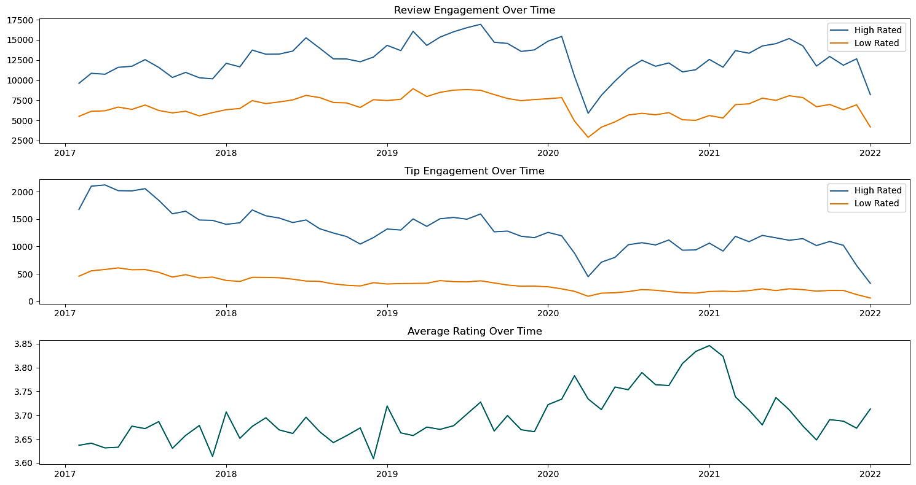
Are there any patterns in user engagement over time for successful
businesses compared to less successful ones?
Successful businesses, particularly those with higher ratings (above 3.5), exhibit consistent and possibly increasing user engagement over time.
High rated restaurants
maintain a steady
growth or growing
level of user
engagement over time,
reflecting ongoing
customer interest and
satisfaction.
Drop due to COVID
14

Slide 15
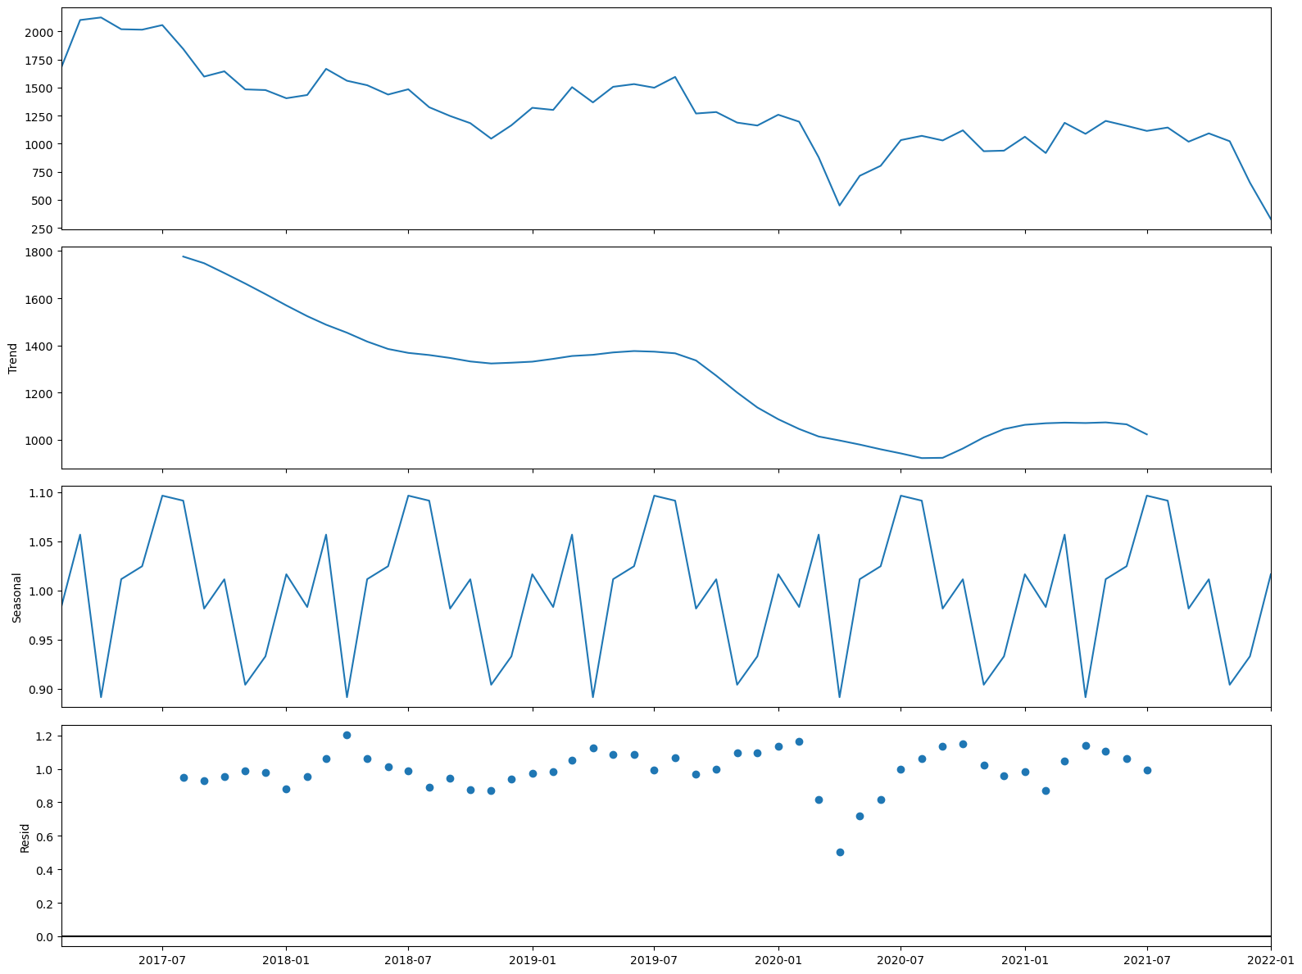
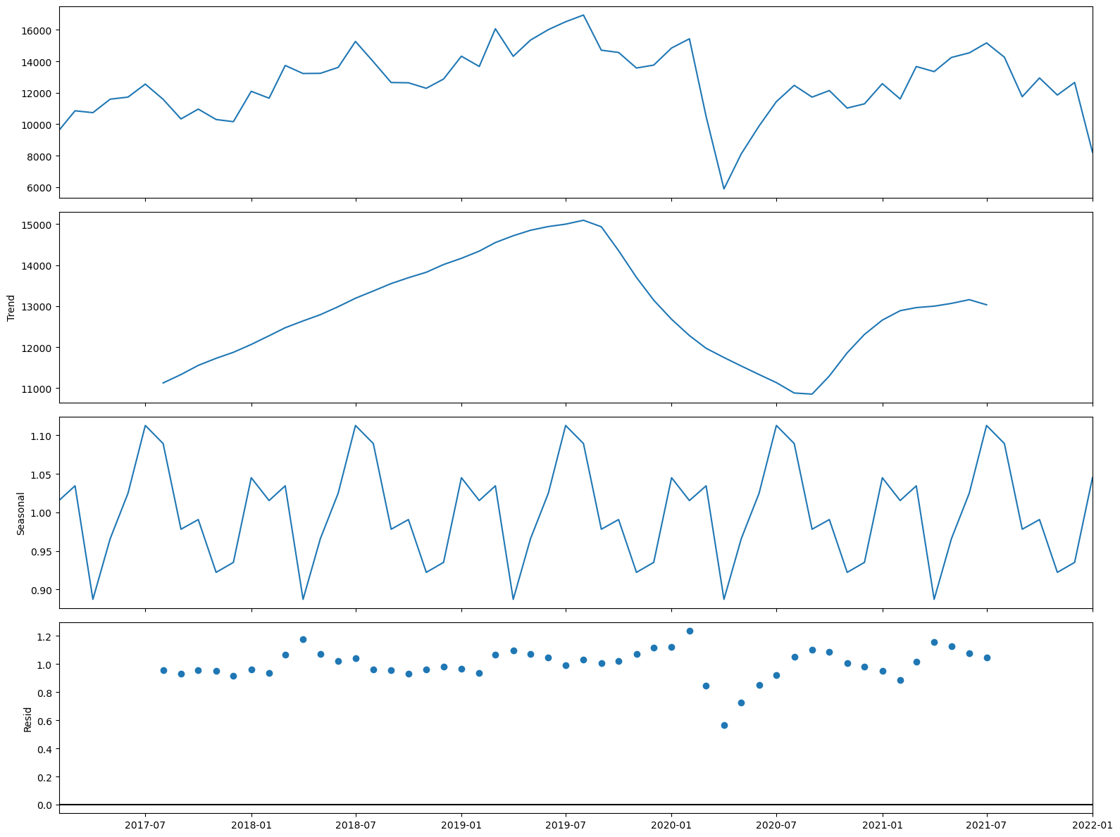
Trend and Seasonality Analysis
Tip Count
Review Count
Upward Trend
Downward Trend
Year Starting and Ending (Nov – Mar) is Highly Engaging
15

Slide 16
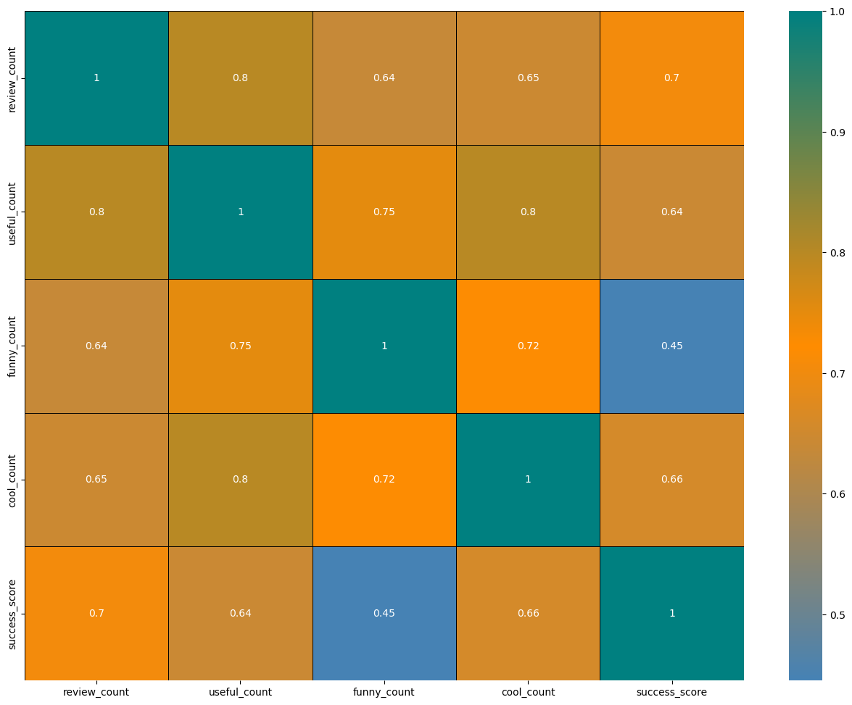
How does the sentiment of reviews and tips (useful, funny, cool) correlate with the success metrics of restaurants?
"useful," "funny," and "cool" are
attributes associated with user reviews.
They represent the feedback provided by
users about the usefulness, humor,
or coolness of a particular review.
Higher counts of useful, funny, and cool
reviews suggest greater user engagement
and satisfaction, which are key factors
contributing to a restaurant’s success.
16

Slide 17
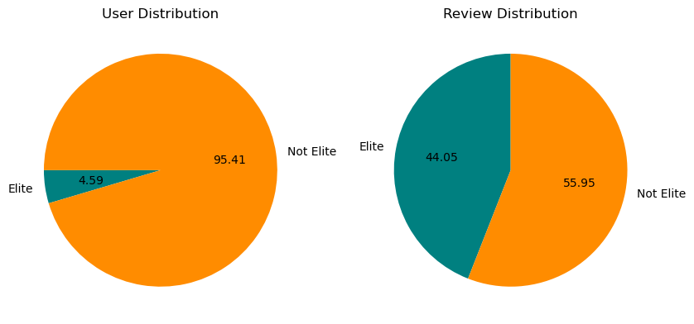
Is there any difference in engagement of elite users and non elite users?
Elite users are individuals who have been recognized and awarded the "Elite" status by Yelp for their active and high-quality contributions.
Elite users, despite being significantly fewer in number, contribute a substantial proportion of the total review count compared to non-elite users.
Establishing a positive relationship with elite users can lead to repeat visits and loyalty, as they are more likely to continue supporting businesses they have had good experiences with.
17

Slide 18
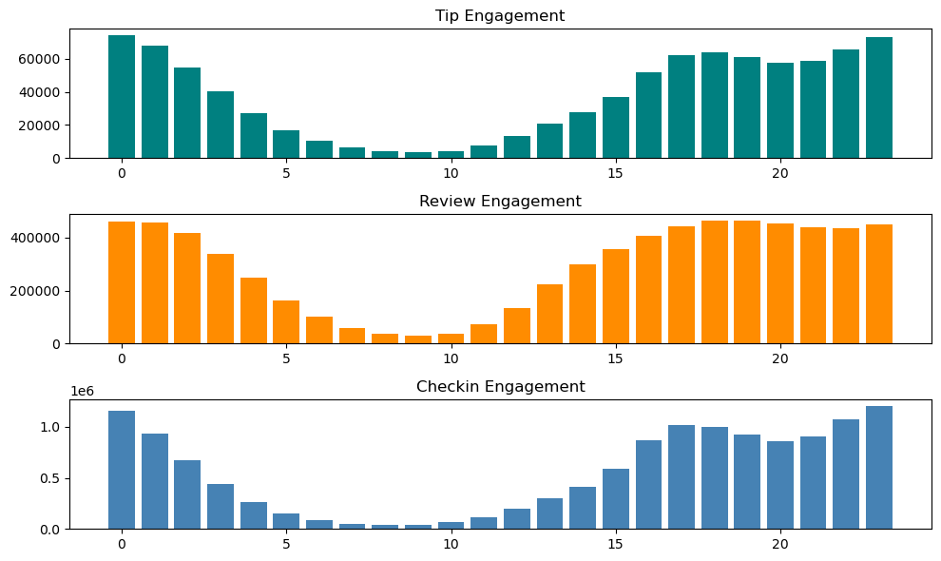
Busiest Hours
The busiest hours for restaurants, based on user engagement, span from 4 pm to 1am.
Knowing the peak hours allows businesses to optimize their staffing levels and resource allocation during these times to ensure efficient operations and quality service delivery.
The concentration of user engagement during the evening and night hours suggests a higher demand for dining out during these times, potentially driven by factors such as work schedules, social
gatherings and leisure
activities.
18

Slide 19
RECOMMENDATIONS
Leverage Elite Users: Identify and engage with influential users to amplify promotional efforts and drive customer acquisition.
Optimize Operating Hours: Adjust business hours to capitalize on peak demand and maximize revenue.
Enhance User Engagement: Focus on improving service quality, responding to customer feedback, and running engaging campaigns for businesses with lower success scores.
Capitalize on Successful Markets: Expand or invest in cities with high success scores to capitalize on market potential.
Data-Driven Decision Making: Continuously monitor key metrics and adjust strategies based on data-driven insights to ensure ongoing success.

Slide 20

Summary
This project leverages the Yelp dataset to explore the impact of user engagement—through reviews, tips, and check-ins—on restaurant performance metrics such as ratings and review counts. By analyzing correlations, sentiment trends, and engagement consistency over time, the findings offer actionable insights for restaurant stakeholders to enhance customer satisfaction, optimize business strategies, and drive long-term success in the competitive restaurant industry.

Slide 21

Thank You
Nafis Ansari
774-583-8294​
nafisansari786@outlook.com​
My Portfolio

